Slide 1
Python Example
https://github.com/swkim94/cocktail
Sangwoo Kim
swkim94@gmail.com
https://www.linkedin.com/in/sangwoo-kim/

Slide 2
Summary
Python Proficiency: Demonstrates core programming competency and data engineering depth.
API Data Collection: Fetches and parses raw dataset using a public API.
Text Vectorization: Transforms unstructured data into numeric vectors for analysis.
Dimensionality Reduction: Implements PCA to reduce feature space and compress data.
Cluster Separation: Groups data points cleanly using K-Nearest Neighbors (KNN).
Custom Visualizations: Generates explanatory histograms and PCA-mapped cluster plots.
Hardware Automation Note: my background in instrument automation relies on LabVIEW.
Source code: Fully open-source repository hosted at https://github.com/swkim94/cocktail
Notes:
Others = 1783
Vodka = 534
Gin = 369
Orange Juice = 243
Kahlua & Irish creasm = 152

Slide 3

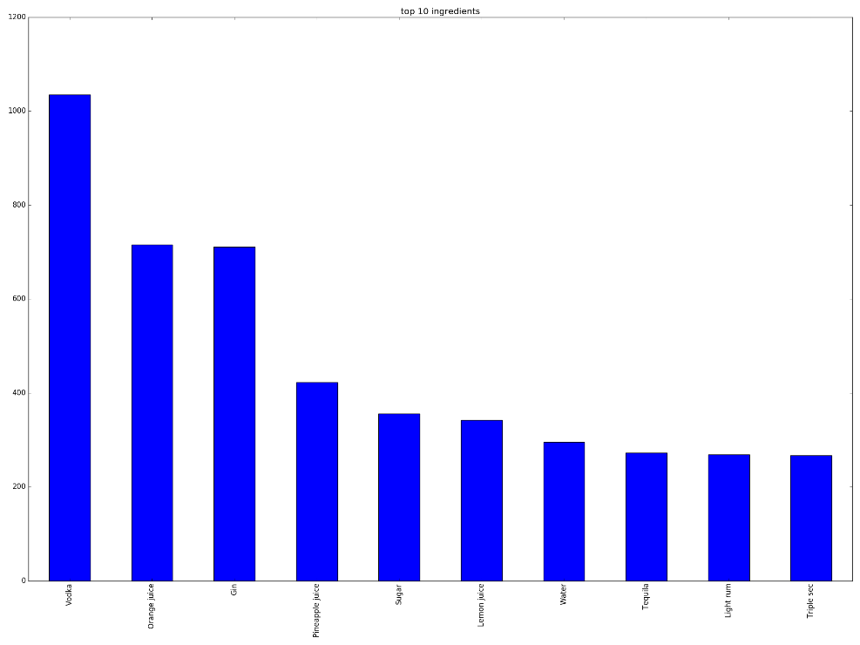




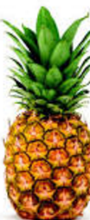

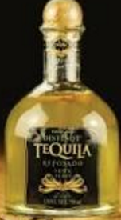



Slide#1: Import Data, Build Pandas Dataframe
3081 cocktails
416 ingredients
http://www.TheCocktailDB.com
10 most popular ingredients
Orange Juice
Pineapple Juice
Lemon Juice
Light rum
Vodka
Water
Tequila
Triple sec
Gin
Sugar

Slide 4
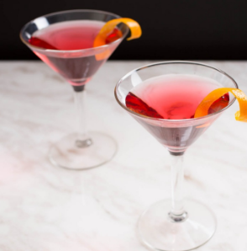
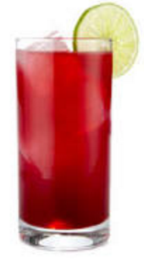
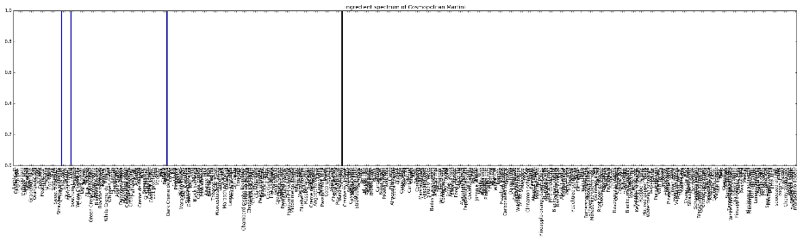
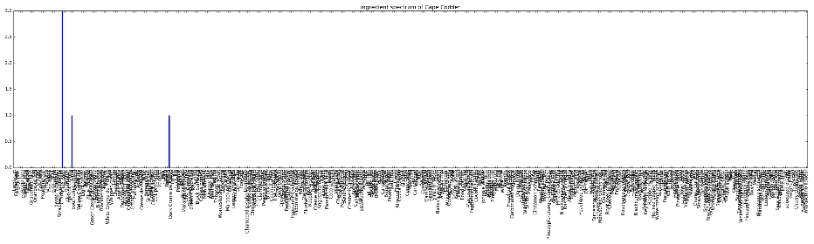
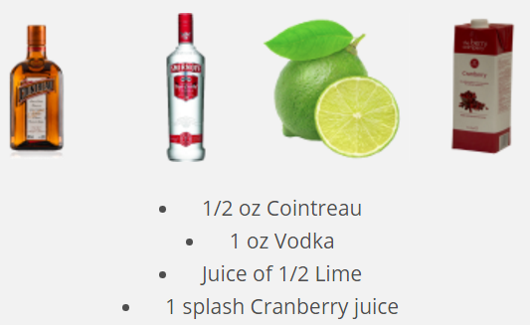
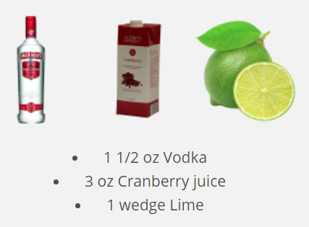
Slide#2: Recommendation (Similarity Search)
Input: Cosmopolitan Martini
Output: Cape Codder
(score=0.75)
volume
volume
ingredients
ingredients

Slide 5
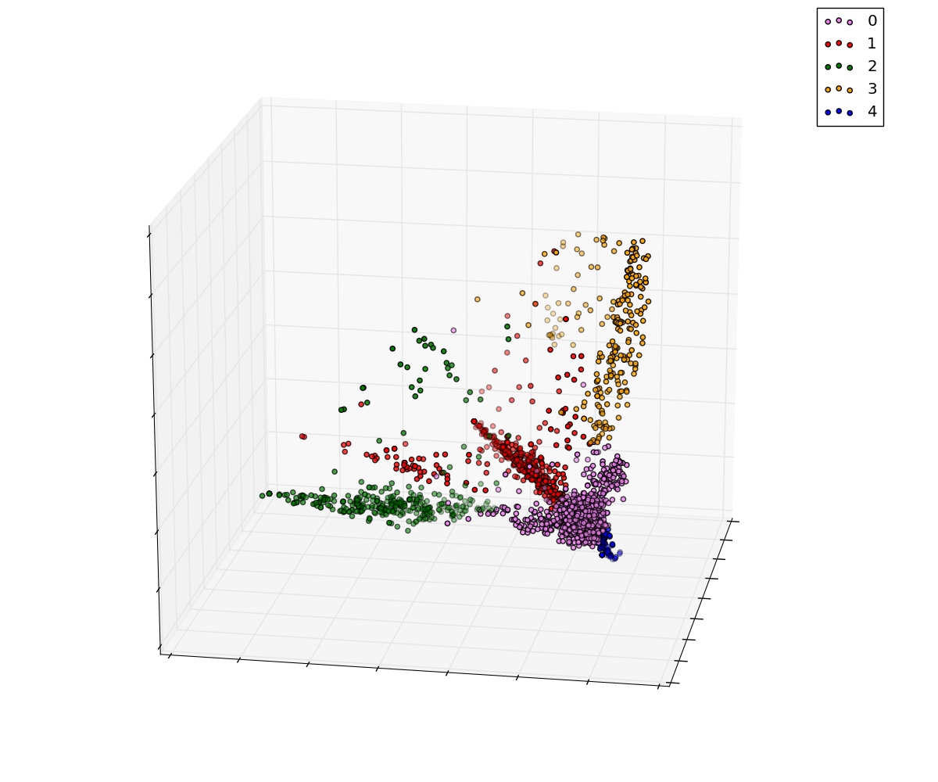
Slide#3: PCA and Clustering
“Orange Juice”
“Vodka”
“Others”
“Gin”
“Kahlua & Irish Cream”

Slide 6
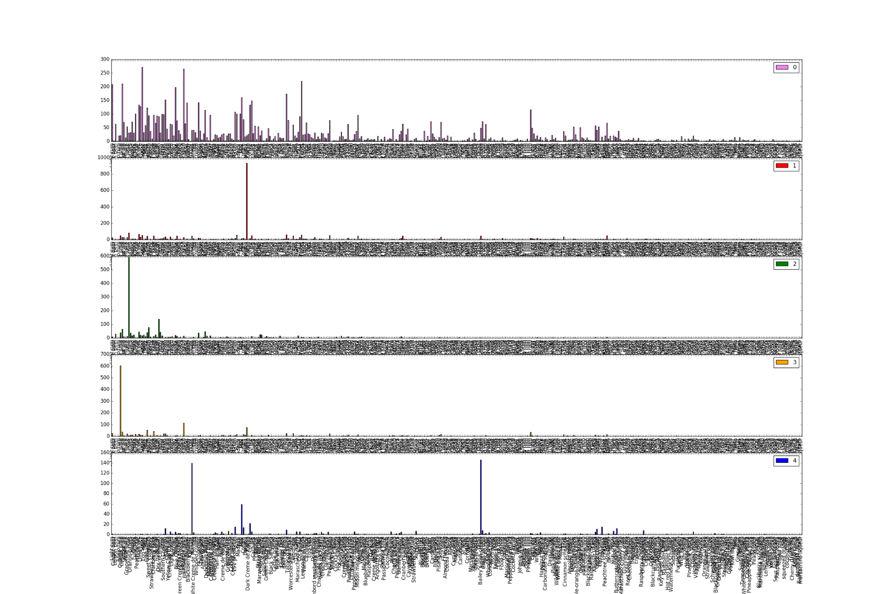
Slide#4: Market Segmentation
“Others” (58%)
“Vodka” (17%)
“Gin” (12%)
“Orange Juice” (8%)
“Kahlua & Irish cream” (5%)
volume
ingredients
Notes:
Others = 1783
Vodka = 534
Gin = 369
Orange Juice = 243
Kahlua & Irish creasm = 152

Slide 7
Thank you!
Notes:
<number>

